Slide 1
Chapter 18: Security on z/OS

Slide 2
Objectives
In this chapter you will learn to:
  Explain security and integrity concepts
  Explain RACF and its interface with the operating system
  Authorize a program
  Discuss integrity concepts
  Explain the importance of change control
  Explain the concept of risk assessment

Slide 3
Key terms
authorized libraries
authorized program facility (APF)
encryption
SAF
SVC
PASSWORD
firewall
hacker
page protection bit
Resource Access Control Facility (RACF)
security policy
separation of duties
system integrity
user ID

Slide 4
Introduction
An installation’s data and programs are among its most valuable assets and must be protected
At one time data was secure because no one knew how to access it
As more people become computer literate and able to use simple tools unprotected data is becoming more accessible
Data security is now more important than ever including the prevention of inadvertent destruction

Slide 5
Why security?
Any system security must allow authorized users the access they need and prevent unauthorized access.
Many companies’ critical data is now on computer and is easily stolen if not protected
z/OS Security Server provides a framework of services to protect data

Slide 6
RACF
RACF (part of Security Server) and the other available packages are add-on products which provide the basic security framework on a z/OS mainframe
Identify and authenticate users
Authorize users to access protected resources
Log and report attempted unauthorized access
Control means of access to resources

Slide 7
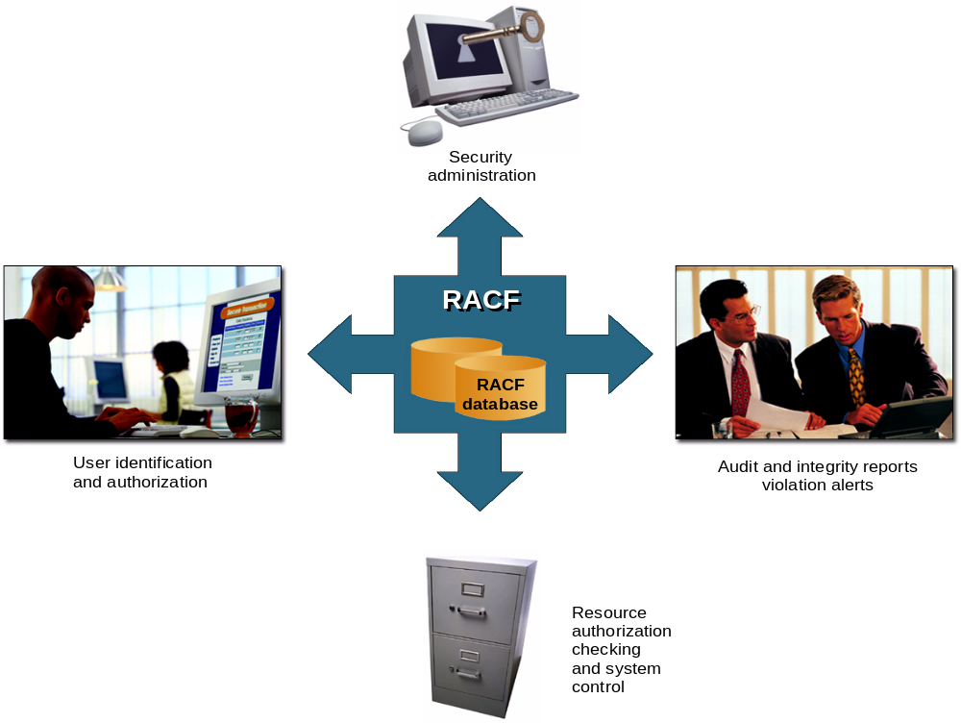
Fig 19-1 RACF functions overview

Slide 8
Identification and verification of users
RACF uses a userid and system encrypted password to perform its user identification and verification
The userid identified the person to the system
The password verifies the user’s identity
Passwords should not be trivial and exits can be used to enforce policies.

Slide 9
Protection Levels
RACF works on a hierarchical structure
  ALLOC allows data set creation and destruction
  CONTROL allows VSAM repro
  WRITE allows update of data
  READ allows read of data
  NONE no access
A higher permission implies all those below

Slide 10
Protecting a dataset
A data set profile is created and stored in the database
It will give users or groups an access level
A universal access level will also be set
The profile can be specific or generic, with or without wild cards

Slide 11
RACF typical display
INFORMATION FOR DATASET SYS1.*.** (G)
LEVEL OWNER UNIVERSAL ACCESS WARNING ERASE
----- -------- ------------------------------ ------- -----
00 SYS1 READ NO NO
AUDITING
--------
FAILURES(READ)
NOTIFY
--------
NO USER TO BE NOTIFIED
YOUR ACCESS CREATION GROUP DATASET TYPE
-------------------- -------------------------- ----------------------
ALTER SYS1 NON-VSAM

Slide 12
RACF access list for SYS1.*.**
ID ACCESS
-------- -------
SYS1 ALTER
KARRAS ALTER
WANDRER ALTER
SCHUBER ALTER
KURTKR UPDATE
KURTKR2 UPDATE
KURTKR3 NONE
CICSRS1 ALTER
CICSRS2 ALTER
HEISIG UPDATE
JUSTO UPDATE
GERALD READ

Slide 13
Protecting general resources
Many system resources can be protected
  DASD volumes
  Tapes
  CICS or IMS transactions
  JES spool datasets
  System commands
  Application resources and many more
RACF is flexible and more can be added

Slide 14
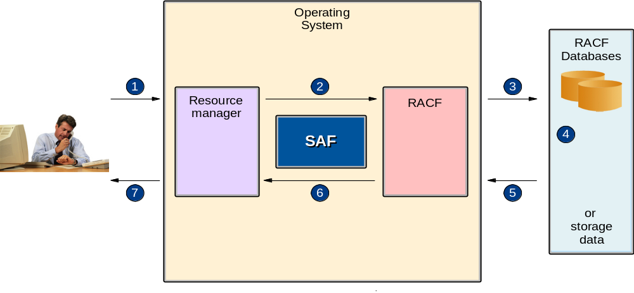
Fig 19-2 Operating system and RACF

Slide 15
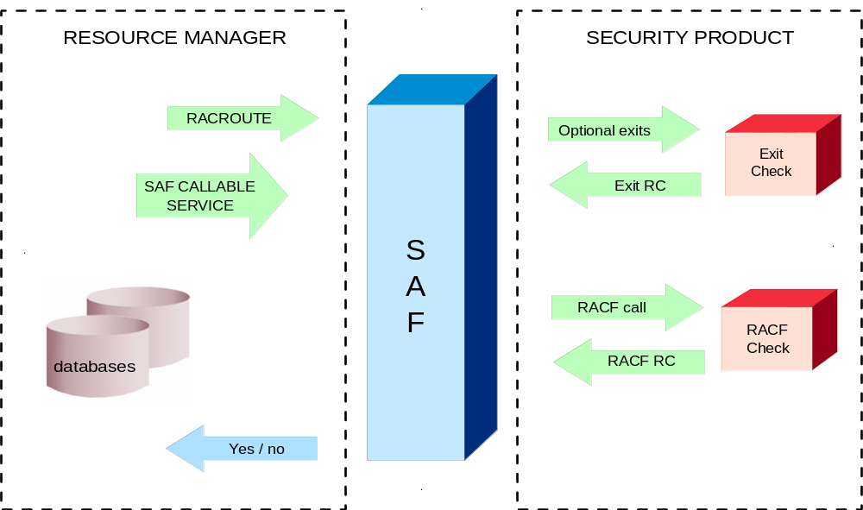
Fig 19-3 Concepts of RACF profile checking

Slide 16
System Authorization Facility
SAF is part of z/OS
Uses RACF if it is present
Can also use an optional exit routine
SAF is a system service and is a common focal point for all products providing resource control.
SAF is invoked at control points within the code of the resource manager

Slide 17
RACF Structure
Userid
Group
  Every userid belongs to at least one group
  Group structures are often used for access to resources
Resource
Resource classes
Class descriptor table – used to customize

Slide 18
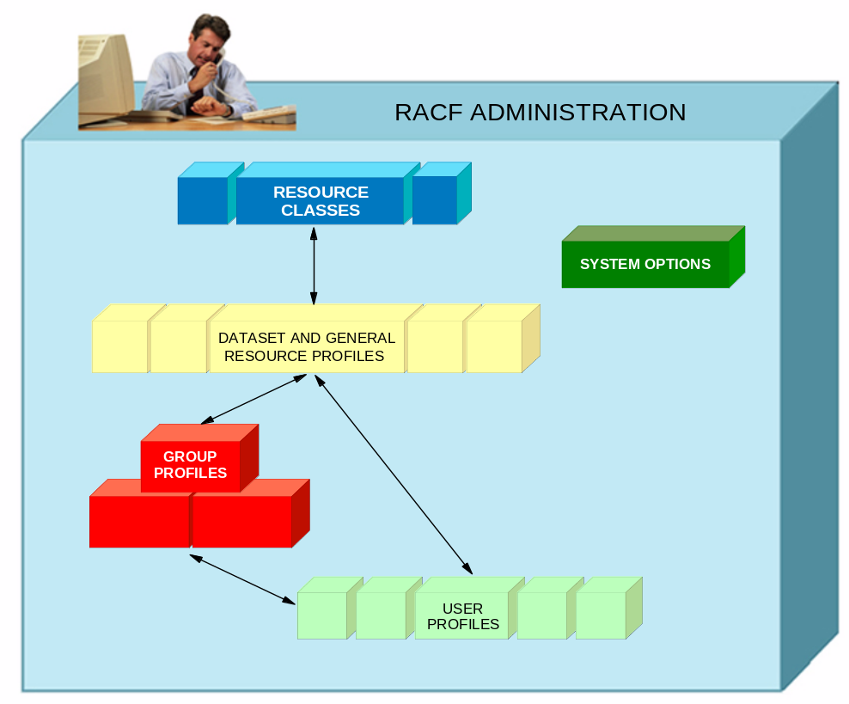
Fig19-4 RACF structure overview

Slide 19
RACF Functions

Slide 20
User Identification
RACF identifies you when you logon
Userid and password are required
Each RACF userid has a unique password
Password is one way encrypted so no one else can get your password not even the administrator
Userid is revoked after a preset number of invalid password attempts

Slide 21
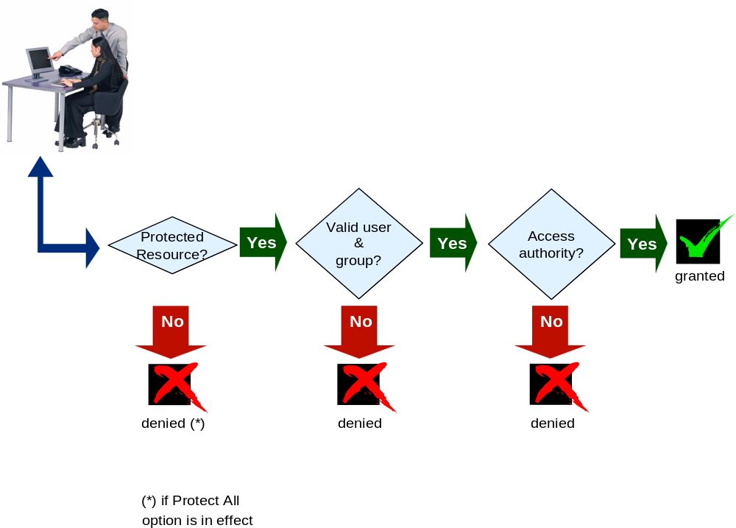
RACF profile checking

Slide 22
Logging and reporting
RACF maintains statistical information
RACF writes a security log when it detects:
  Unauthorized attempts to enter the system
  Access to resources
    This depends on the settings for the resource
    For example AUDIT(ALL(UPDATE) will record all updates to a resource
  Issuing of commands

Slide 23
Security Administration
Interpret the security policy to:
  Determine which RACF functions to use
  Identify the level of RACF protection
  Identify which data to protect
  Identify administrative structures and users

Slide 24
RACF sysplex data sharing and RRSF
If many systems share a RACF database there can be contention problems
RACF will propagate commands throughout a sysplex
RACF can use a coupling facility in a parallel sysplex to improve performance
RRSF can be used to keep distributed RACF databases in line

Slide 25
Authorized programs
Authorized tasks running authorized programs are allowed to access sensitive system functions
Unauthorized programs may only use standard functions to avoid integrity problems

Slide 26
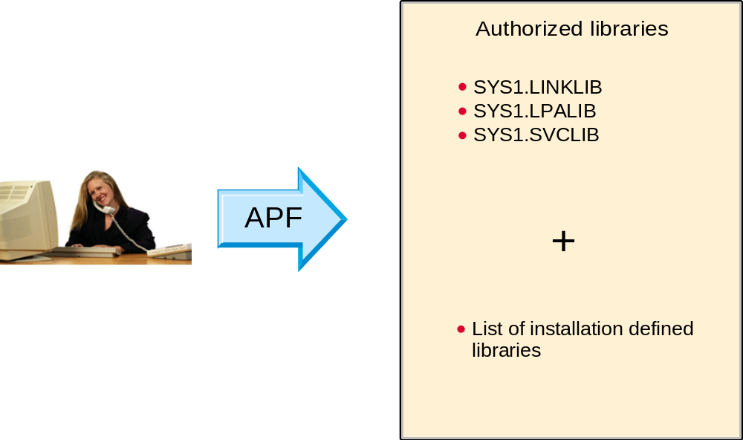
Fig 19-7 Authorized Program Facility

Slide 27
Authorized Libraries
A task is authorized when the executing program has the following characteristics:
  It runs in supervisor state
  It runs in PSW key 0 to 7
  All previous programs in the same task were APF programs
  The module was loaded from an APF library

Slide 28
Problem Programs
Normal programs are known as problem programs as they run in problem state (as opposed to supervisor state)
They run in the problem key – 8
They may or may not be in an APF library

Slide 29
APF Libraries
Authorized libraries are defined by the APF list in SYS1.PARMLIB
SYS1.LINKLIB, SYS1.SVCLIB and SYS1.LPALIB are automatically authorized
Installation libraries are defined in PROGxx
By default all libraries in the linklist are authorized but many installations set LNKAUTH=APFTAB, often prompted by auditors, so that this is no longer the case and only those in the list are authorized

Slide 30
Authorizing a program
The first, and only the first, load module of the program must be linked with the authorization code AC=1
It and all subsequent modules must be loaded from an authorized library
APF libraries must be protected so that only authorized users can store programs there

Slide 31
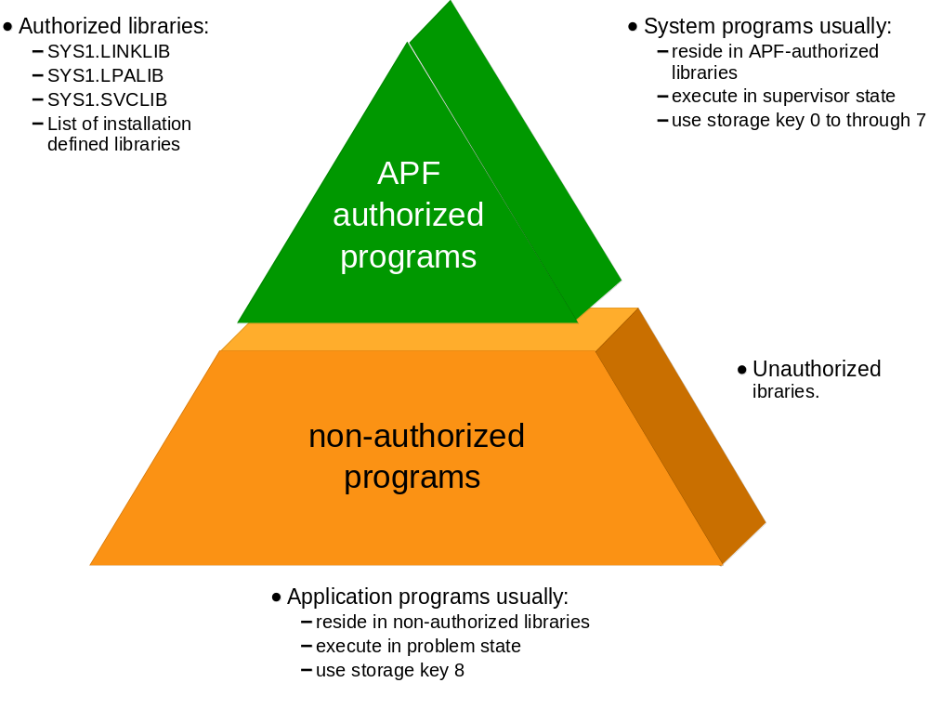
Fig 19-8 Authorizing libraries

Slide 32
Authorizing libraries
The APF list is built during IPL using those libraries listed in the PROGxx parmlib member
If a dynamic list is specified then it may be updated by operator command

Slide 33
An example APF list
BROWSE SYS1.PARMLIB(PROGTT) - 01.01 Line 00000000 Col 001 080
Command ===> Scroll ===> PAGE
*************************** Top of Data ********************************
APF FORMAT(DYNAMIC)
APF ADD
DSNAME(SYS1.VTAMLIB)
VOLUME(******)
APF ADD
DSNAME(SYS1.SICELINK)
VOLUME(******)
APF ADD
DSNAME(SYS1.LOCAL.VTAMLIB)
VOLUME(TOTCAT)
APF ADD
DSNAME(ISP.SISPLOAD)
VOLUME(*MCAT*)
*************************** Bottom of Data *****************************

Slide 34
Dynamic APF
Update a PROGxx member and then activate it with operator command SET PROG=xx
Use the SETPROG APF command
DISPLAY PROG,APF command will display the current list

Slide 35
D PROG,APF
D PROG,APF
CSV450I 12.46.27 PROG,APF DISPLAY 027
FORMAT=DYNAMIC
ENTRY VOLUME DSNAME
1 Z04RE1 SYS1.LINKLIB
2 Z04RE1 SYS1.SVCLIB
3 Z04RE1 ANF.SANFLOAD
4 Z04RE2 AOP.SAOPLOAD
5 Z04RE1 AOP.SAOPLOAD
6 Z04RE1 ARTURO.BFSLMOD
7 Z04RE1 ASMA.V1R2M0.SASMMOD1
8 TOTDBZ ASN.V7R1M0.SASNALNK
9 TOTDBZ ASN.V7R1M0.SASNLLNK
10 TOTDBZ ASN.V8R1M0.SASNLOAD
11 TOTPT1 ASNA.V5R1M0.SASNALNK
12 TOTPT1 ASNL.V5R1M0.SASNLLNK
……

Slide 36
Operator Console Security
Consoles are assigned authority levels in CONSOLxx parmlib member
Commands are grouped:
  INFO informational commands
  SYS system control commands
  IO I/O commands
  CONS console control commands
  MASTER master console commands
Each console may have one or more levels

Slide 37
Consoles
At least one console must have master authority
In a sysplex consoles are shared
It is possible to require logon to consoles using RACF
All extended MCS consoles should require a logon

Slide 38
Security Roles
Systems programmer sets up RACF
Systems administrator implements the policies
Security Manager sets the policies
Separation of duties is required to prevent uncontrolled access

Slide 39
Summary
z/OS Security Server
RACF
SAF
Authorized Programs
APF list
Console security

Slide 40
